Slide 1
Tolerant retrievals - Wild-card queries, Spelling correction, Soundex

Slide 2
Organizations
Ch. 3
Dictionary data structures
Already Studied
“Tolerant” retrieval
Wild-card queries
Spelling correction
Soundex – we will not study.

Slide 3
Soundex
Sec. 3.4
Class of heuristics to expand a query into phonetic equivalents
Language specific – mainly for names
E.g., chebyshev → tchebycheff
Invented for the U.S. census … in 1918

Slide 4
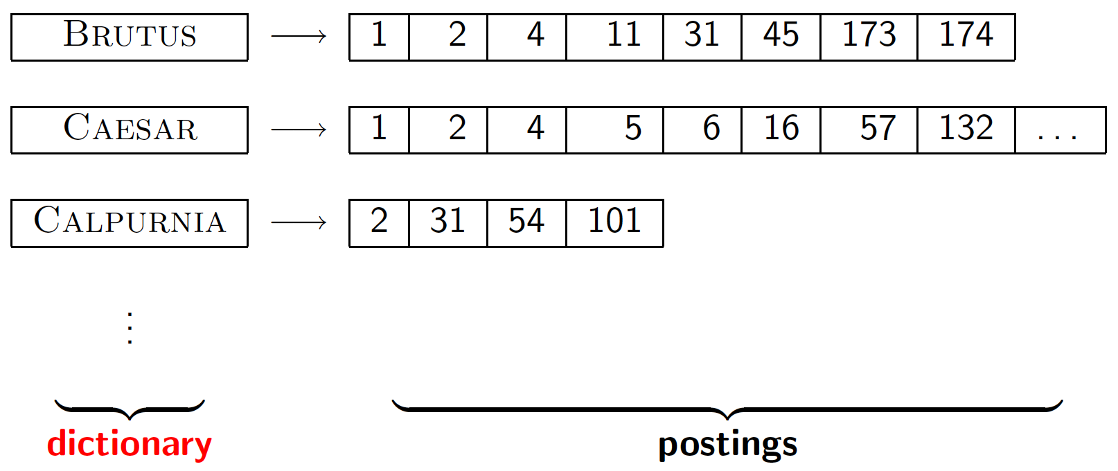
Dictionary data structures for inverted indexes
Sec. 3.1
The dictionary data structure stores the term vocabulary, document frequency, pointers to each postings list … in what data structure?

Slide 5
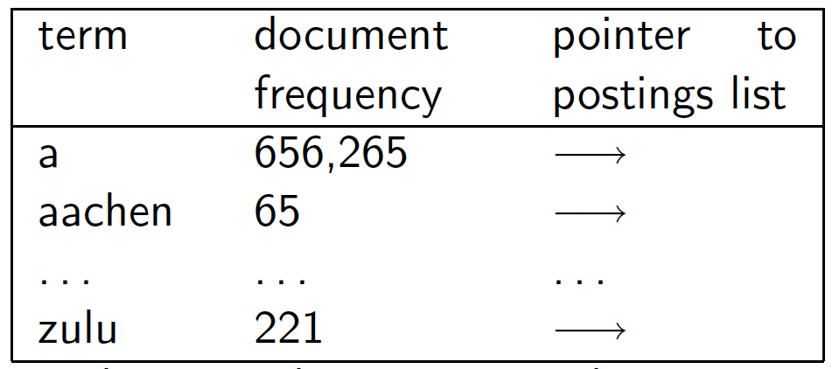
A naïve dictionary
Sec. 3.1
An array of struct:
char[20] int Postings *
20 bytes 4/8 bytes 4/8 bytes
How do we store a dictionary in memory efficiently?
How do we quickly look up elements at query time?

Slide 6
Dictionary data structures
Sec. 3.1
Two main choices:
Hashtables
Trees
Some IR systems use hashtables, some trees

Slide 7
Hashtables
Sec. 3.1
Each vocabulary term is hashed to an integer
(We assume you’ve seen hashtables before)
Pros:
Lookup is faster than for a tree: O(1)
Cons:
No easy way to find minor variants:
judgment/judgement
No prefix search [tolerant retrieval]
If vocabulary keeps growing, need to occasionally do the expensive operation of rehashing everything

Slide 8
Tree: binary tree
Sec. 3.1
Root
a-m
n-z
a-hu
hy-m
n-sh
si-z
huygens
sickle
zygot
aardvark

Slide 9
Tree: B-tree
Sec. 3.1
a-hu
n-z
hy-m
Definition: Every internal nodel has a number of children in the interval [a,b] where a, b are appropriate natural numbers, e.g., [2,4].

Slide 10
Trees
Sec. 3.1
Simplest: binary tree
More usual: B-trees
Trees require a standard ordering of characters and hence strings … but we typically have one
Pros:
Solves the prefix problem (terms starting with hyp)
Cons:
Slower: O(log M) [and this requires balanced tree]
Rebalancing binary trees is expensive
But B-trees mitigate the rebalancing problem

Slide 11
Wild-card queries

Slide 12
Wild-card queries: *
Sec. 3.2
mon*: find all docs containing any word beginning with “mon”.
Easy with binary tree (or B-tree) lexicon: retrieve all words in range: mon ≤ w < moo
*mon: find words ending in “mon”: harder
Maintain an additional B-tree for terms backwards.
Can retrieve all words in range: nom ≤ w < non.
How can we enumerate all terms meeting the wild-card query pro*cent ?

Slide 13
Query processing
Sec. 3.2
At this point, we have an enumeration of all terms in the dictionary that match the wild-card query.
We still have to look up the postings for each enumerated term.
E.g., consider the query:
se*ate AND fil*er
This may result in the execution of many Boolean AND queries.

Slide 14
B-trees handle *’s at the end of a query term
Sec. 3.2
How can we handle *’s in the middle of query term?
co*tion
We could look up co* AND *tion in a B-tree and intersect the two term sets
Expensive
The solution: transform wild-card queries so that the *’s occur at the end
This gives rise to the Permuterm Index.

Slide 15
Permuterm index
Sec. 3.2.1
Add a $ to the end of each term
Rotate the resulting term and index them in a B-tree
For term hello, index under:
hello$, ello$h, llo$he, lo$hel, o$hell, $hello
where $ is a special symbol.
hello$
ello$h
llo$he
Empirically, dictionary
quadruples in size
hello
lo$hel
o$hell
$hello

Slide 16
Permuterm query processing
Sec. 3.2.1
(Add $), rotate * to end, lookup in permuterm index
Queries:
X
X*
*X
*X*
X*Y
X*Y*Z
lookup on X$ hello$ for hello
lookup on $X* $hel* for hel*
lookup on X$* llo$* for *llo
lookup on X* ell* for *ell*
lookup on Y$X* lo$h for h*lo
treat as a search for X*Z and post-filter For h*a*o, search for h*o by looking up o$h* and post-filter hello and retain halo

Slide 17
Permuterm index
Sec. 3.2.1
For term hello, index under:
hello$, ello$h, llo$he, lo$hel, o$hell, $hello
where $ is a special symbol.
Queries:
X lookup on X$ X* lookup on $X*
*X lookup on X$* *X* lookup on X*
X*Y lookup on Y$X* X*Y*Z ??? Exercise!
Query = hel*o
X=hel, Y=o
Lookup o$hel*

Slide 18
Permuterm query processing
Sec. 3.2.1
Rotate query wild-card to the right
Now use B-tree lookup as before.
Permuterm problem: ≈ quadruples lexicon size
Empirical observation for English.

Slide 19
Bigram (k-gram) indexes
Sec. 3.2.2
Enumerate all k-grams (sequence of k chars) occurring in any term
e.g., from text “April is the cruelest month” we get the 2-grams (bigrams)
$ is a special word boundary symbol
Maintain a second inverted index from bigrams to dictionary terms that match each bigram.
$a,ap,pr,ri,il,l$,$i,is,s$,$t,th,he,e$,$c,cr,ru,
ue,el,le,es,st,t$, $m,mo,on,nt,h$

Slide 20
Bigram index example
Sec. 3.2.2
The k-gram index finds terms based on a query consisting of k-grams (here k=2).
$m
mace
madden
monday
mo
among
amortize
monday
on
along
among
monday

Slide 21
Processing wild-cards
Sec. 3.2.2
Query mon* can now be run as
$m AND mo AND on
Gets terms that match AND version of our wildcard query.
But we’d enumerate moon.
Must post-filter these terms against query.
Surviving enumerated terms are then looked up in the term-document inverted index.
Fast, space efficient (compared to permuterm).

Slide 22
Processing wild-card queries
Sec. 3.2.2
As before, we must execute a Boolean query for each enumerated, filtered term.
Wild-cards can result in expensive query execution (very large disjunctions…)
pyth* AND prog*
If you encourage “laziness” people will respond!
Which web search engines allow wildcard queries?
Search
Type your search terms, use ‘*’ if you need to.
E.g., Alex* will match Alexander.

Slide 23
Spelling correction

Slide 24
Rates of spelling errors
Depending on the application, ~1–20% error rates
26%: Web queries Wang et al. 2003
13%: Retyping, no backspace: Whitelaw et al. English&German
7%: Words corrected retyping on phone-sized organizer
2%: Words uncorrected on organizer Soukoreff &MacKenzie 2003
1-2%: Retyping: Kane and Wobbrock 2007, Gruden et al. 1983
Notes:
Wang et al 2003l: Mining longitudinal web queries: Trends and patterns
Retyping: subjects were asked to retype a Wikipedia article without using backspace/delete
Soukoreff&MacKenzie: Metrics for text entry research

Slide 25
Spelling Tasks
Spelling Error Detection
Spelling Error Correction:
Autocorrect
hte→the
Suggest a correction
Suggestion lists
Notes:
HCI issues and confidence determine.

Slide 26
Spell correction
Sec. 3.3
Two principal uses
Correcting document(s) being indexed
Correcting user queries to retrieve “right” answers
Two main flavors:
Isolated word
Check each word on its own for misspelling
Will not catch typos resulting in correctly spelled words
e.g., from → form
Context-sensitive
Look at surrounding words,
e.g., I flew form Heathrow to Narita.

Slide 27
Types of spelling errors
Non-word Errors
graffe →giraffe
Real-word Errors
Typographical errors
three →there
Cognitive Errors (homophones)
piece→peace,
too → two
your →you’re
Non-word correction was historically mainly context insensitive
Real-word correction almost needs to be context sensitive

Slide 28
Non-word spelling errors
Non-word spelling error detection:
Any word not in a dictionary is an error
The larger the dictionary the better … up to a point
(The Web is full of mis-spellings, so the Web isn’t necessarily a great dictionary …)
Non-word spelling error correction:
Generate candidates: real words that are similar to error
Choose the one which is best:
Shortest weighted edit distance
Highest noisy channel probability
Notes:
Old school spelling correction

Slide 29
Real word & non-word spelling errors
For each word w, generate candidate set:
Find candidate words with similar pronunciations
Find candidate words with similar spellings
Include w in candidate set
Choose best candidate
Noisy Channel view of spell errors
Context-sensitive – so have to consider whether the surrounding words “make sense”
Flying form Heathrow to LAX → Flying from Heathrow to LAX

Slide 30
Document correction
Sec. 3.3
Especially needed for OCR’ed documents
Correction algorithms are tuned for this: rn/m
Can use domain-specific knowledge
E.g., OCR can confuse O and D more often than it would confuse O and I (adjacent on the QWERTY keyboard, so more likely interchanged in typing).
But also: web pages and even printed material have typos
Goal: the dictionary contains fewer misspellings
But often we don’t change the documents and instead fix the query-document mapping

Slide 31
Query mis-spellings
Sec. 3.3
Our principal focus here
E.g., the query Alanis Morisett
We can either
Retrieve documents indexed by the correct spelling, OR
Return several suggested alternative queries with the correct spelling
Did you mean … ?

Slide 32
Isolated word correction
Sec. 3.3.2
Fundamental premise – there is a lexicon from which the correct spellings come
Two basic choices for this
A standard lexicon such as
Webster’s English Dictionary
An “industry-specific” lexicon – hand-maintained
The lexicon of the indexed corpus
E.g., all words on the web
All names, acronyms etc.
(Including the mis-spellings)

Slide 33
Isolated word correction
Sec. 3.3.2
Given a lexicon and a character sequence Q, return the words in the lexicon closest to Q
What’s “closest”?
We’ll study several alternatives
Edit distance (Levenshtein distance)
Weighted edit distance
n-gram overlap

Slide 34
Edit distance
Sec. 3.3.3
Given two strings S₁ and S₂, the minimum number of operations to convert one to the other
Operations are typically character-level
Insert, Delete, Replace, (Transposition)
E.g., the edit distance from dof to dog is 1
From cat to act is 2 (Just 1 with transpose.)
from cat to dog is 3.
Generally found by dynamic programming.
See http://www.merriampark.com/ld.htm for a nice example plus an applet.

Slide 35
Weighted edit distance
Sec. 3.3.3
As above, but the weight of an operation depends on the character(s) involved
Meant to capture OCR or keyboard errors Example: m more likely to be mis-typed as n than as q
Therefore, replacing m by n is a smaller edit distance than by q
This may be formulated as a probability model
Requires weight matrix as input
Modify dynamic programming to handle weights

Slide 36
Using edit distances
Sec. 3.3.4
Given query, first enumerate all character sequences within a preset (weighted) edit distance (e.g., 2)
Intersect this set with list of “correct” words
Show terms you found to user as suggestions
Alternatively,
We can look up all possible corrections in our inverted index and return all docs … slow
We can run with a single most likely correction
The alternatives disempower the user, but save a round of interaction with the user

Slide 37
Edit distance to all dictionary terms?
Sec. 3.3.4
Given a (mis-spelled) query – do we compute its edit distance to every dictionary term?
Expensive and slow
Alternative?
How do we cut the set of candidate dictionary terms?
One possibility is to use n-gram overlap for this
This can also be used by itself for spelling correction.
Notes:
Alternative is to generate everything up to edit distance k and then intersect. Fine for distance 1; okay for distance 2. This is generally enough (Norvig).

Slide 38
n-gram overlap
Sec. 3.3.4
Enumerate all the n-grams in the query string as well as in the lexicon
Use the n-gram index (recall wild-card search) to retrieve all lexicon terms matching any of the query n-grams
Threshold by number of matching n-grams
Variants – weight by keyboard layout, etc.

Slide 39
Example with trigrams
Sec. 3.3.4
Suppose the text is november
Trigrams are nov, ove, vem, emb, mbe, ber.
The query is december
Trigrams are dec, ece, cem, emb, mbe, ber.
So 3 trigrams overlap (of 6 in each term)
How can we turn this into a normalized measure of overlap?

Slide 40
One option – Jaccard coefficient
Sec. 3.3.4
A commonly-used measure of overlap
Let X and Y be two sets; then the J.C. is
Equals 1 when X and Y have the same elements and zero when they are disjoint
X and Y don’t have to be of the same size
Always assigns a number between 0 and 1
Now threshold to decide if you have a match
E.g., if J.C. > 0.8, declare a match

Slide 41
Matching trigrams
Sec. 3.3.4
Consider the query lord – we wish to identify words matching 2 of its 3 bigrams (lo, or, rd)
lo
alone
lore
sloth
or
border
lore
morbid
rd
ardent
border
card
Standard postings “merge” will enumerate …
Adapt this to using Jaccard (or another) measure.

Slide 42
Context-sensitive spell correction
Sec. 3.3.5
Text: I flew from Heathrow to Narita.
Consider the phrase query “flew form Heathrow”
We’d like to respond
Did you mean “flew from Heathrow”?
because no docs matched the query phrase.

Slide 43
Context-sensitive correction
Sec. 3.3.5
Need surrounding context to catch this.
First idea: retrieve dictionary terms close (in weighted edit distance) to each query term
Now try all possible resulting phrases with one word “fixed” at a time
flew from heathrow
fled form heathrow
flea form heathrow
Hit-based spelling correction: Suggest the alternative that has lots of hits.
Very difficult in general – No further discussion

Slide 44
Tries
Similar to the balanced binary search tree
Derive from “retrieval”.
Prefix Vs. Suffix.
Ex. “computer”.
Prefix:(c, co, com).
Suffix: (r, er, ter)
Each node in this tree structure corresponds to a prefix of some strings of the set.
If the same prefix occurs several times, there is only one node to represent it.
The root of the tree structure is the node corresponding to the empty prefix.

